Slide 1

Text classification
Peyman Naseri
ADS course presentation
Fall 01-02

Slide 2
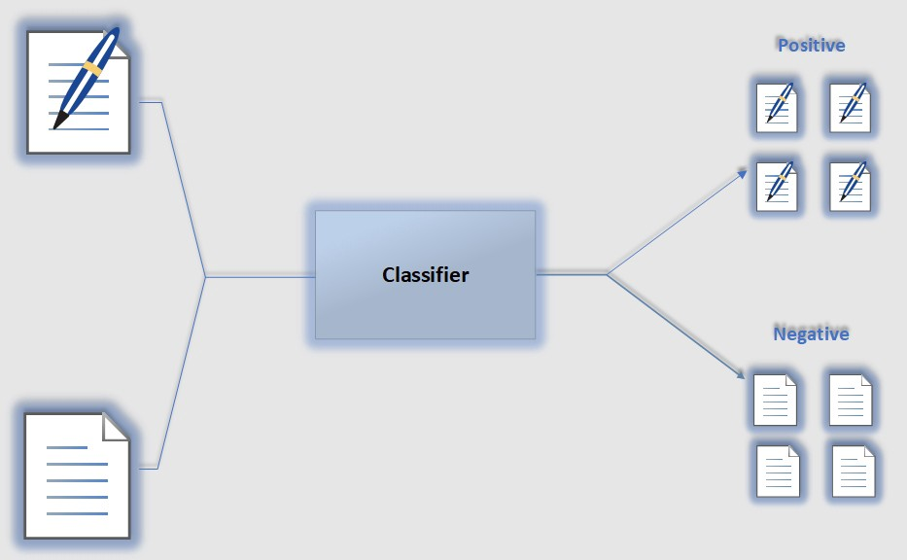
Sentiment Analysis ☺/☹

Slide 3
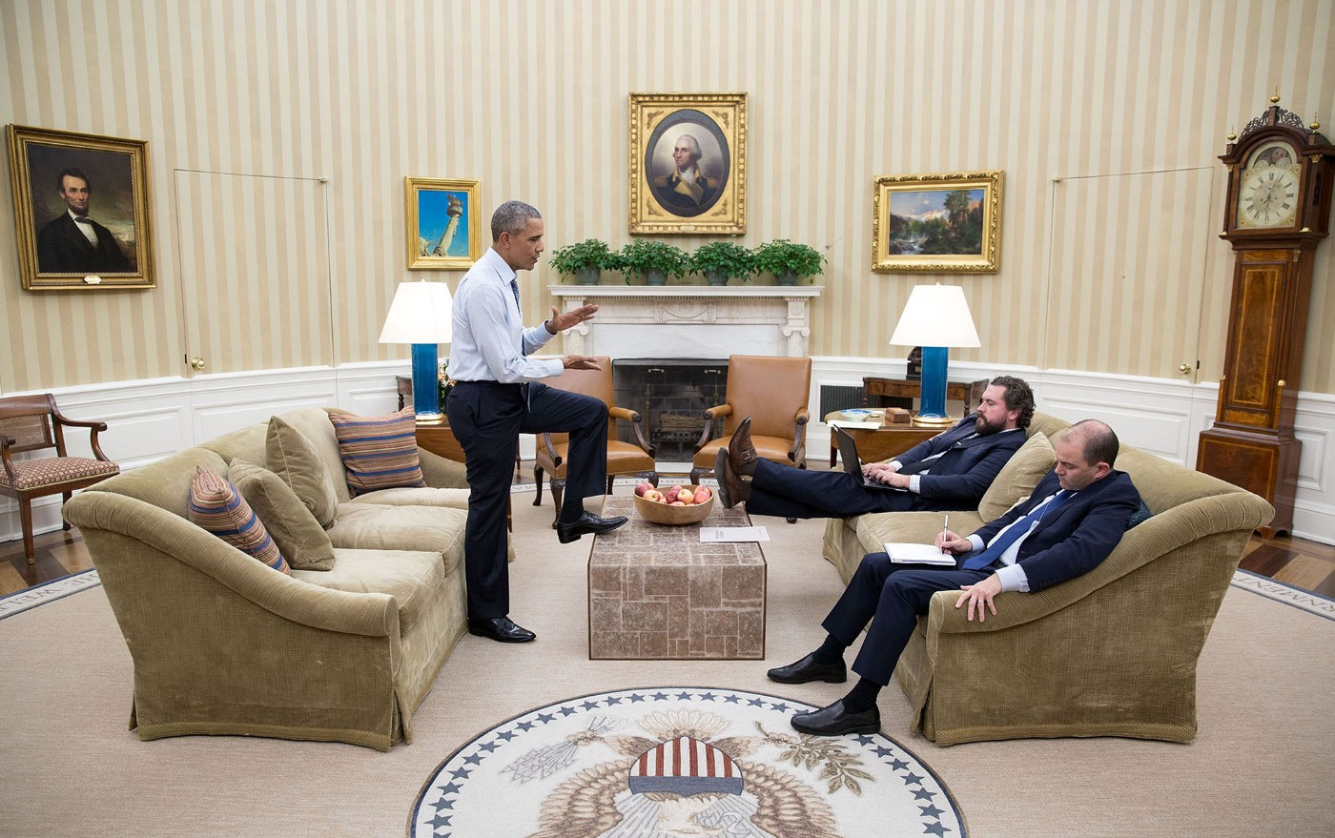

Slide 4




Slide 5



Slide 6
As Data Scientist ☺
Data
Data Collection
Preprocessing
EDA
Feature Engineering (Text Representation)
Models
Classic
Neural Network

Slide 7

Data Collection

Slide 8
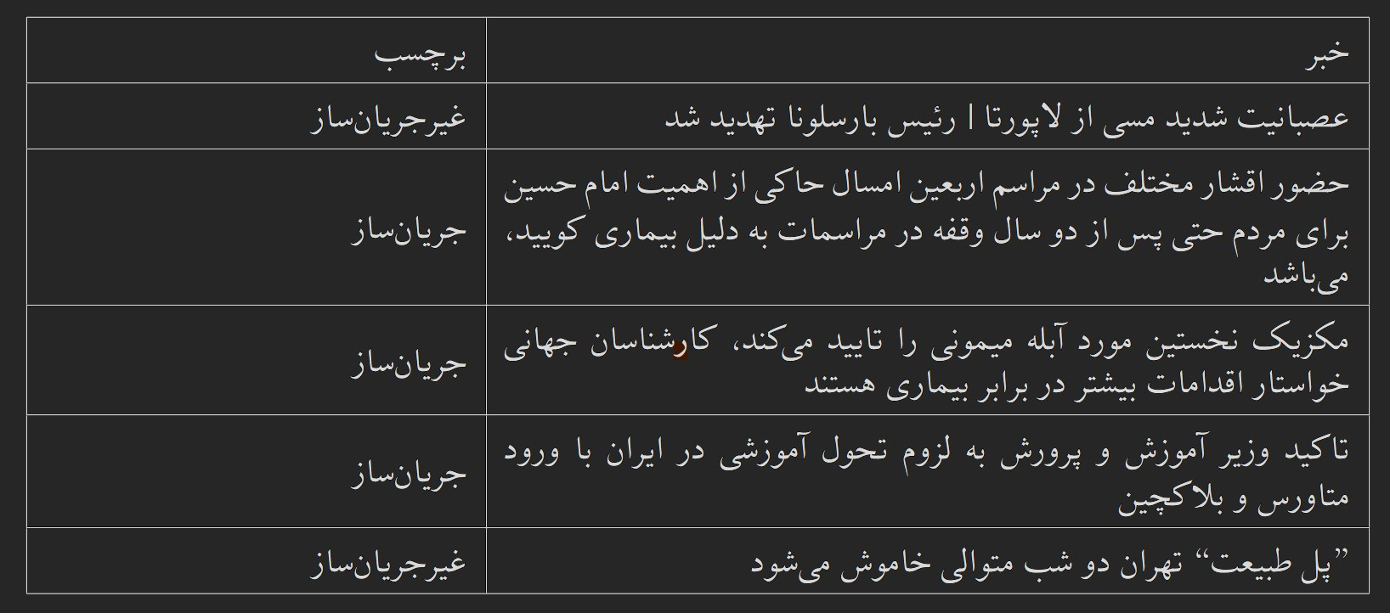
A glimpse of the data...

Slide 9
Preprocessing
فیض رُوح القدس ار باز مـــدد فرماید دیــــگران هم بکنند آن چه مَسیحا می کرد
فیض روح ‌القدس اگر باز مدد فرماید دیگران هم بکنند آن چه مسیح می کرد
فیض روح‌القدس اگر باز مدد فرماید دیگران هم بکنند آن‌چه مسیح می‌کرد
Text
Normalization
Tokenization

Slide 10
Another Preprocessing Techniques
Remove Punctuation
Remove Stop-words
Spelling Correction
Stemming & Lemmatization
Remove Numbers
…

Slide 11
EDA
Unbalanced Data
Text Length Distribution
Visualizing the Most Frequent Word
WordCloud
Visualizing of the Sentimental Words

Slide 12
Feature Engineering or Text Representation or Word Embedding

Slide 13
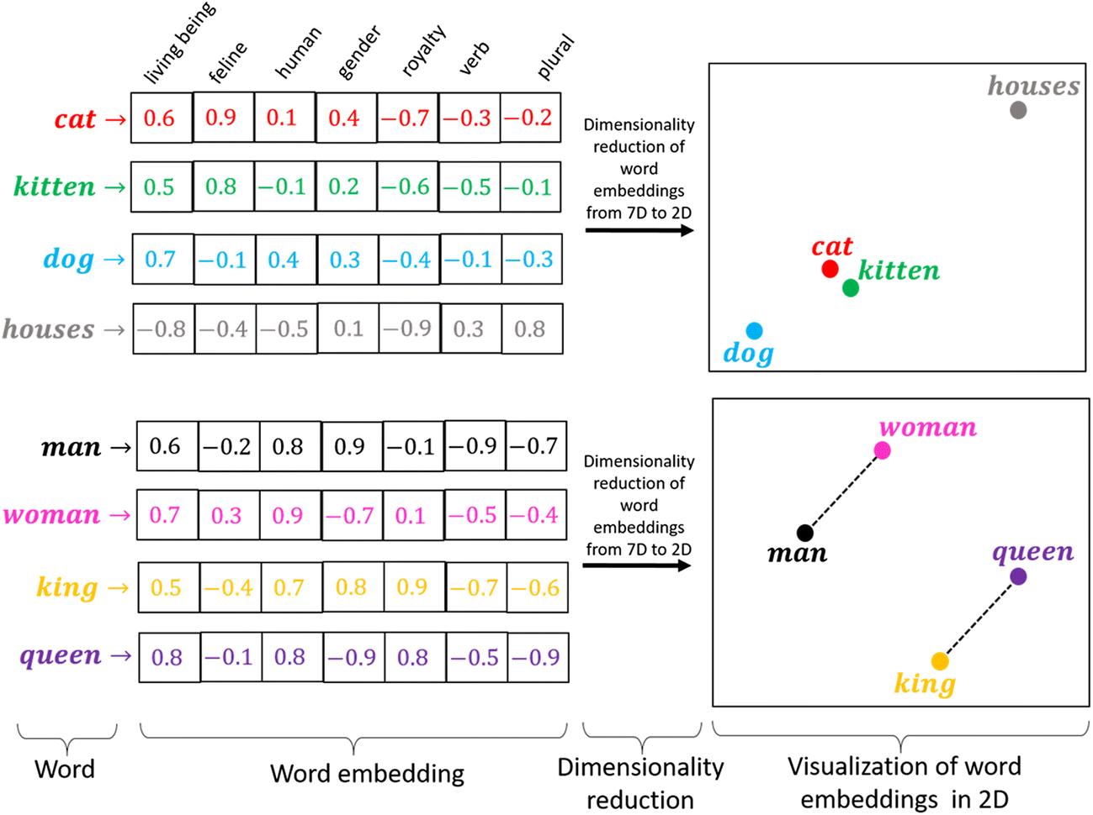
Good Embedding

Slide 14
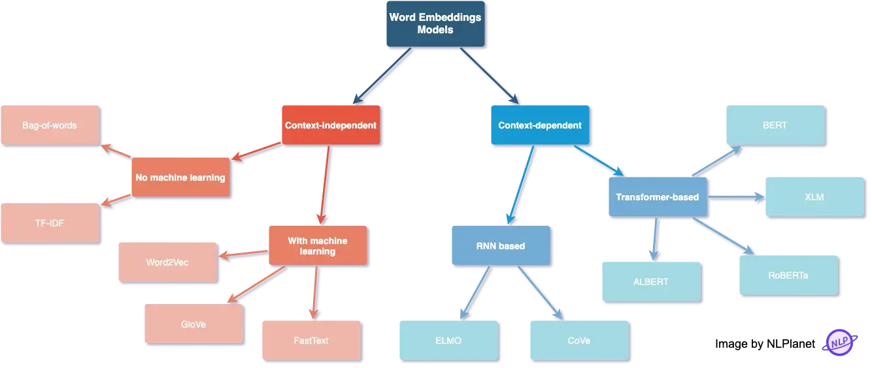
Word Embedding Techniques

Slide 15
Word Embedding
Non-Context Based
One-Hot
TF-IDF
Context Based (Language Model)
RNN
Transformers

Slide 16
Non-Context Based

Slide 17
One-Hot
Dictionary
 | آبی | ایران | اتمام | است | بیمار | بندر | ...
ذخایر | 0 | 0 | 0 | 0 | 0 | 0
آبی | 1 | 0 | 0 | 0 | 0 | 0
ایران | 0 | 1 | 0 | 0 | 0 | 0
در | 0 | 0 | 0 | 0 | 0 | 0
حال | 0 | 0 | 0 | 0 | 0 | 0
اتمام | 0 | 0 | 1 | 0 | 0 | 0
است | 0 | 0 | 0 | 1 | 0 | 0
words

Slide 18
One-Hot
Advantages
Disadvantages

Slide 19
Term Frequency (TF)
Documents
 | BBC | Iran-int | اقتصاد | ورزشی | کیهان | ….
رئیسی | 100 | 50 | 30 | 5 | 500
دلار | 50 | 100 | 300 | 3 | 60
علی دایی | 60 | 50 | 0 | 130 | 5
مهسا امینی | 400 | 500 | 5 | 10 | 1
اعدام | 100 | 50 | 45 | 2 | 70
یارانه | 10 | 15 | 80 | 0 | 27
…
words

Slide 20
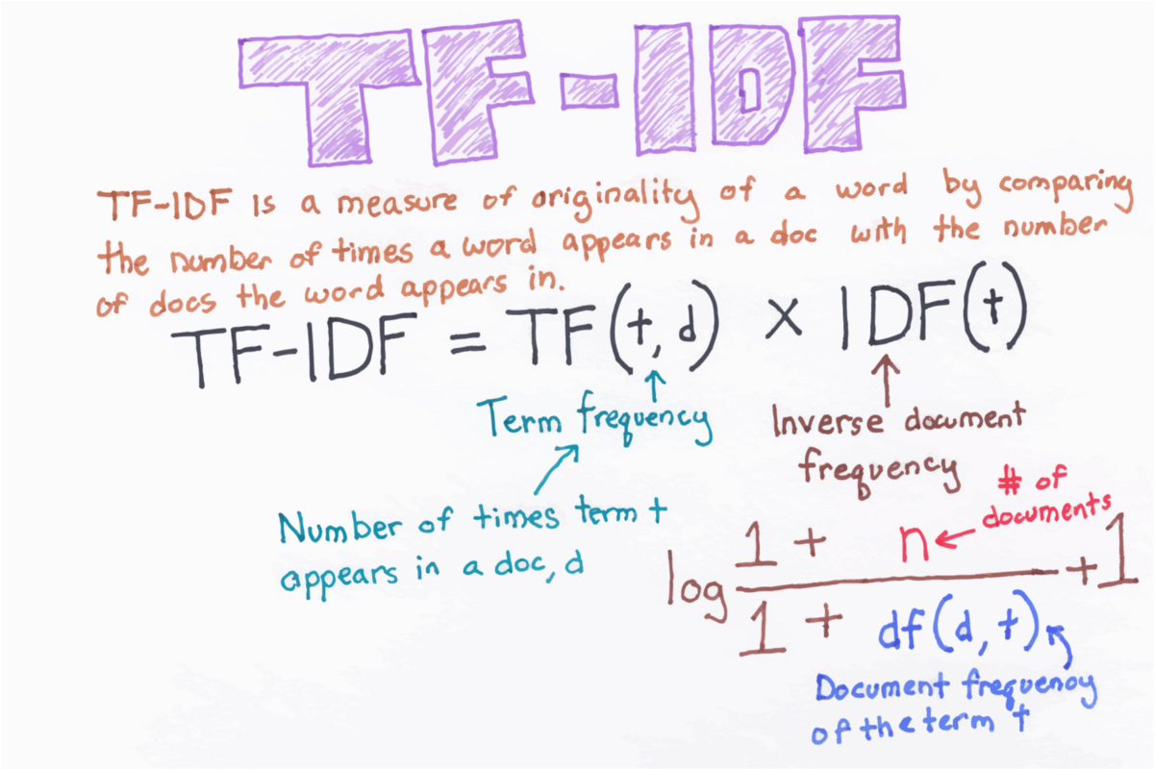

Slide 21
TF-IDF
Advantages
Disadvantages

Slide 22
Context Based

Slide 23
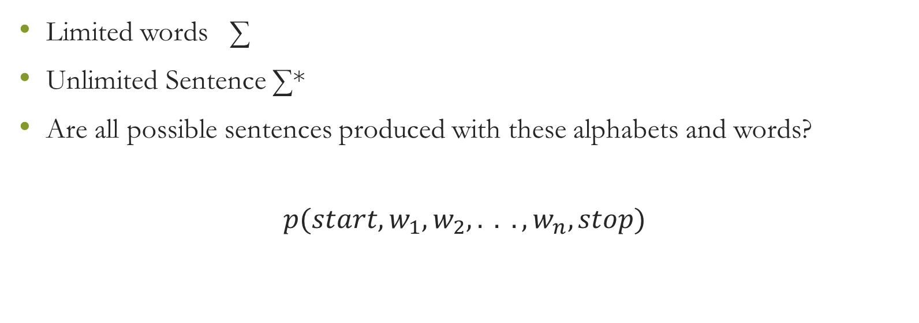
Language Model
Limited words ∑
Unlimited Sentence ∑*
Are all possible sentences produced with these alphabets and words?
$$p(start,w_{1},w_{2},. . .,w_{n}, stop)$$

Slide 24
Language Model
Classic
n-gram
Neural Network
BERT
CBOW
Skip-gram
ELMO

Slide 25
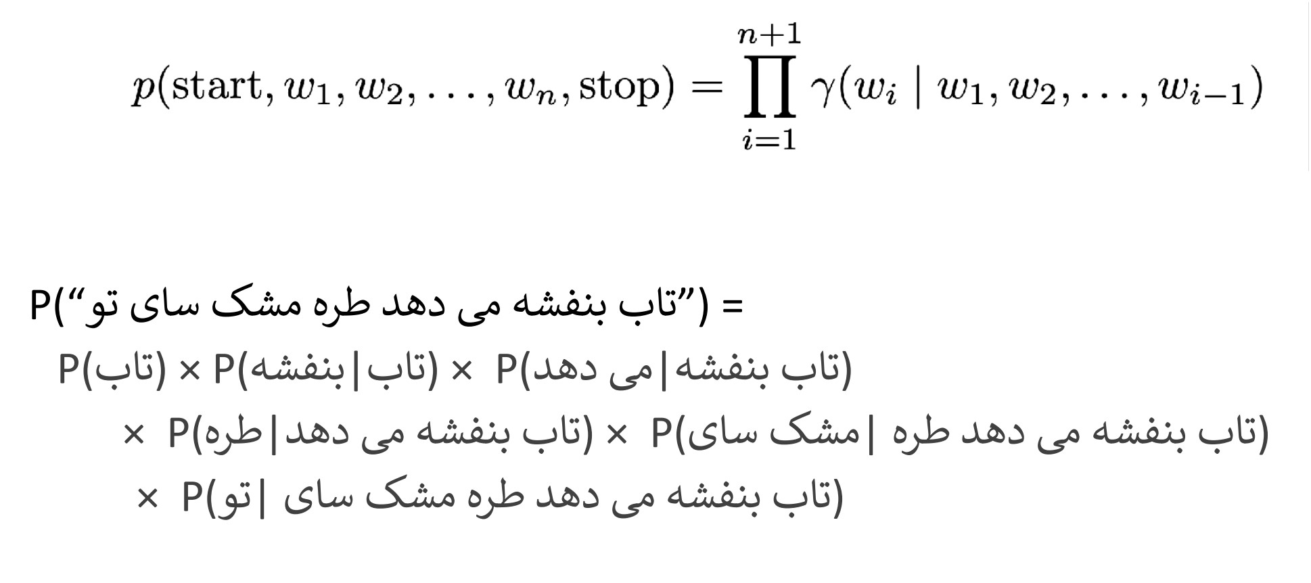
n-gram

Slide 26
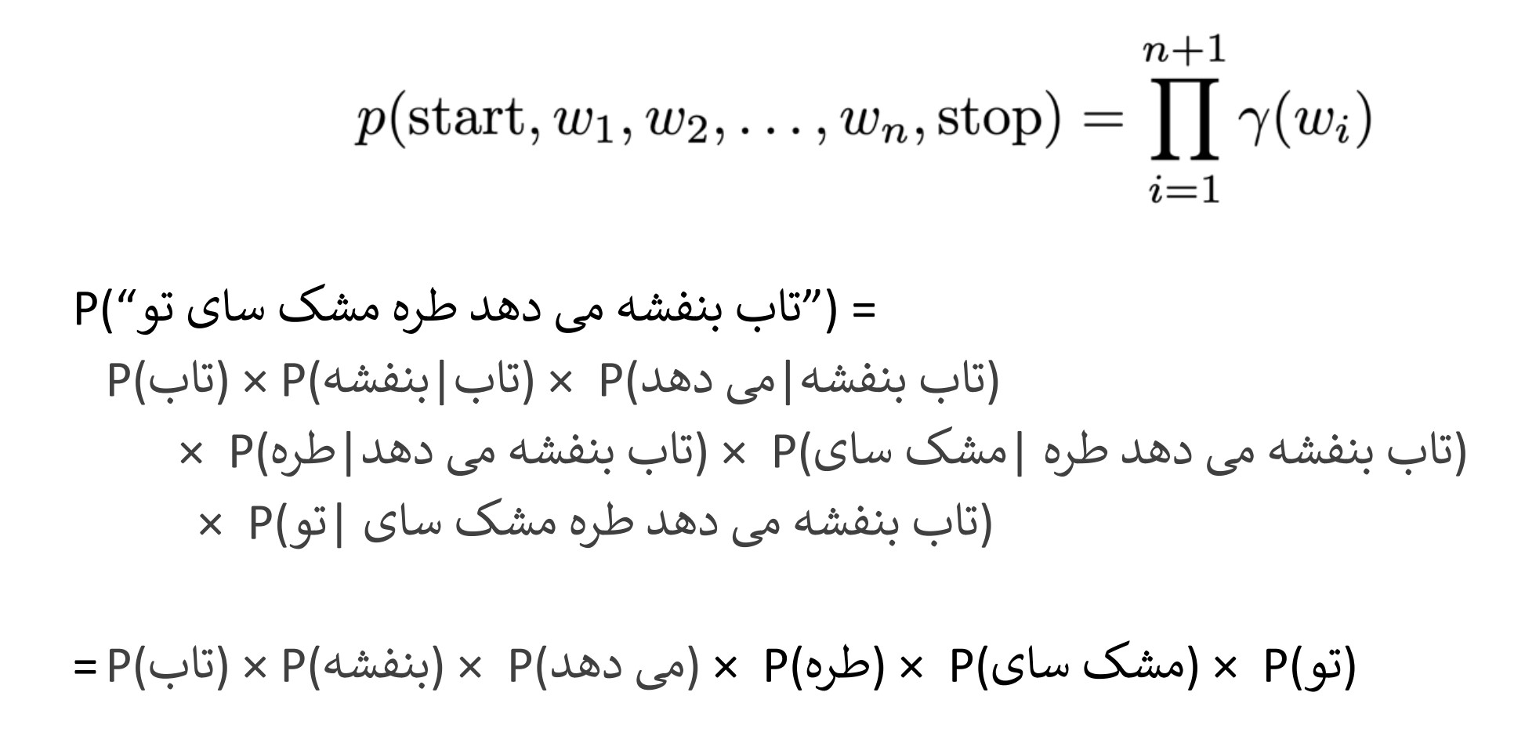
Unigram (Bag of Word)

Slide 27
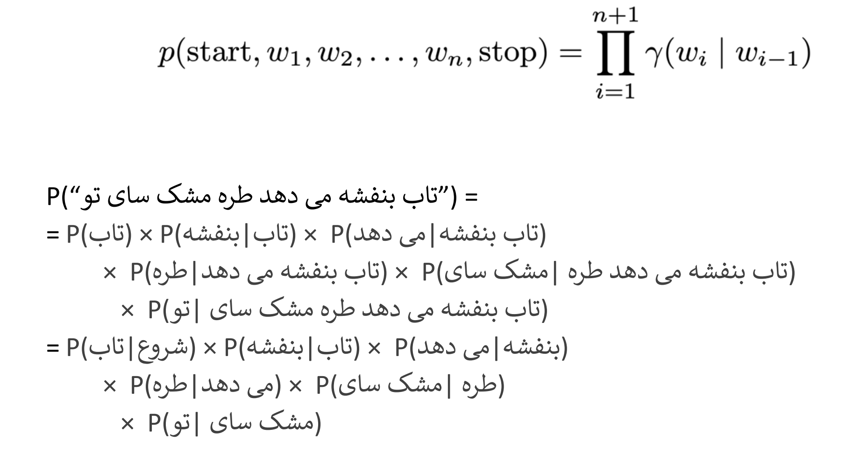
Bigram

Slide 28
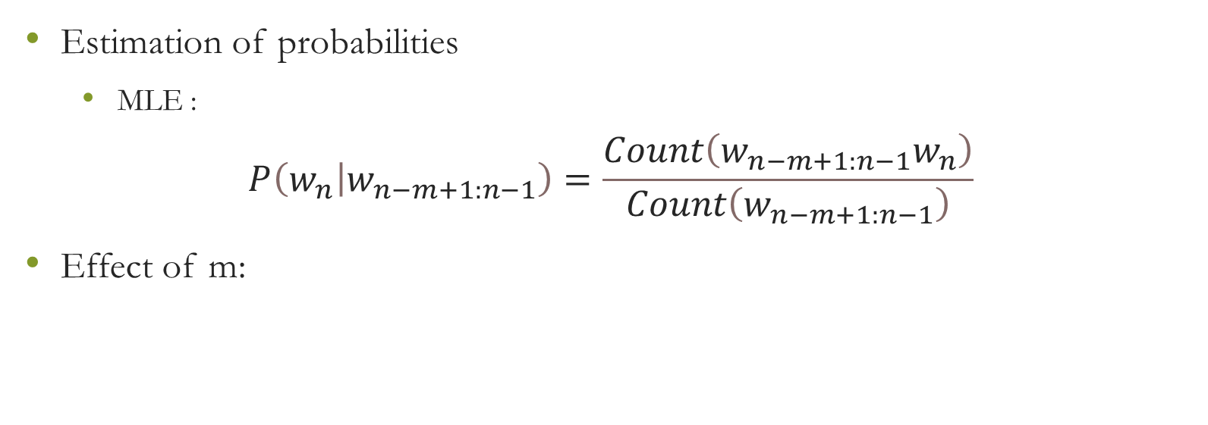
m-gram
Estimation of probabilities
MLE :
$$P\left(\left.w_{n}\right|w_{n−m+1:n−1}\right)=\frac{Count\left(w_{n−m+1:n−1}w_{n}\right)}{Count\left(w_{n−m+1:n−1}\right)}$$
Effect of m:
independent words
entire history
0
m
∞

Slide 29
Neural Network
MLP
RNN
Vanilla
LSTM
Attention Mechanism
Transformers
Bert

Slide 30
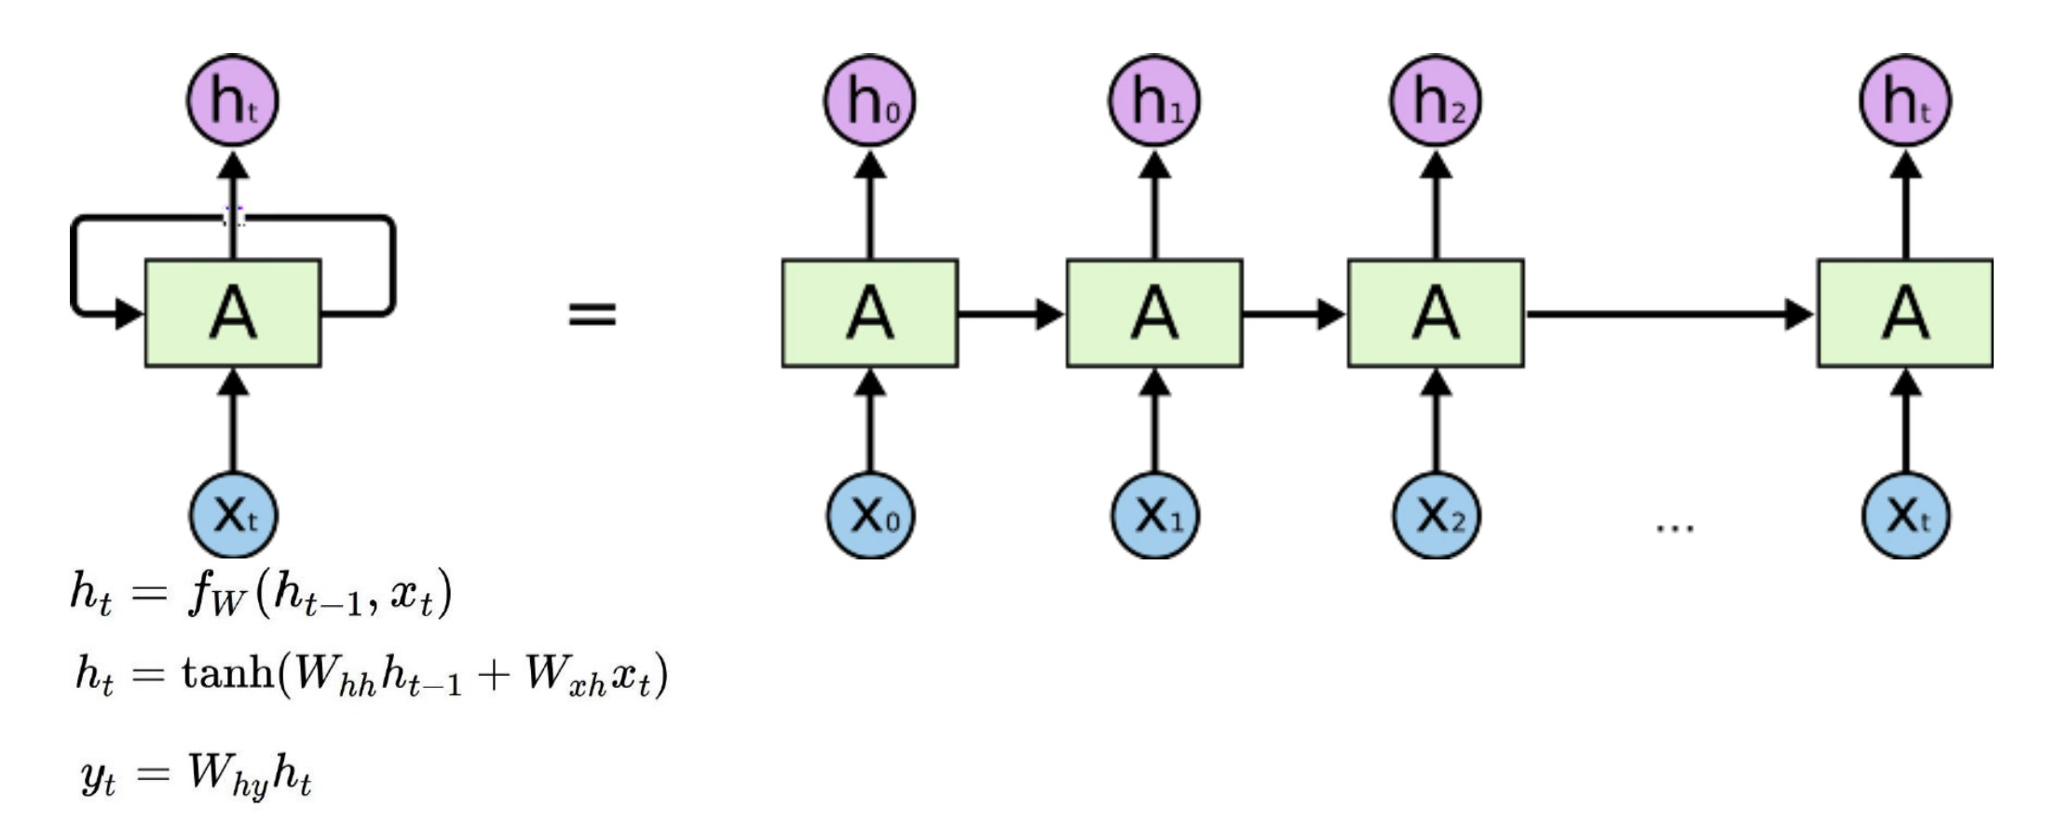
Vanilla

Slide 31
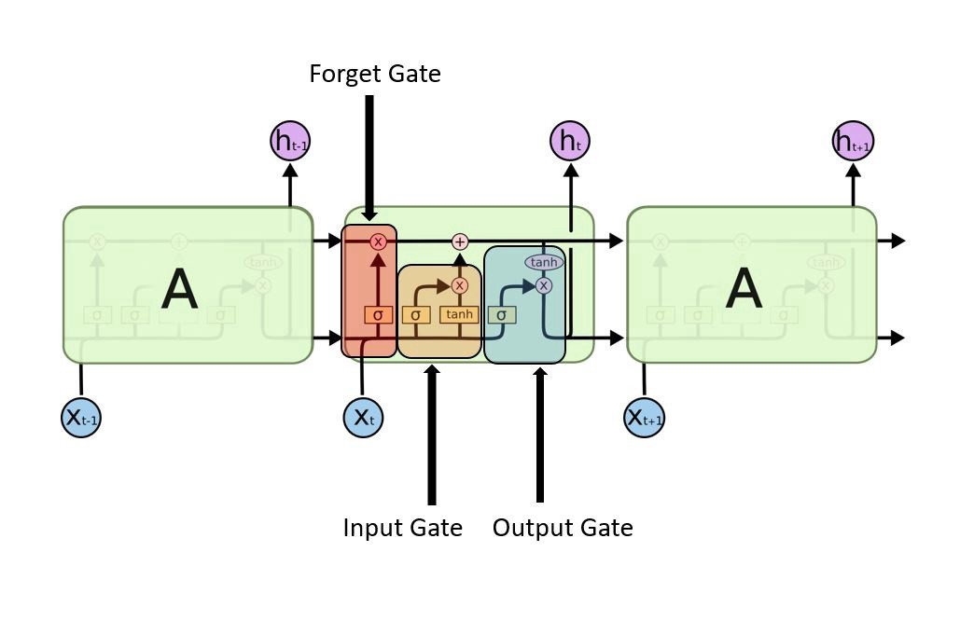
LSTM

Slide 32
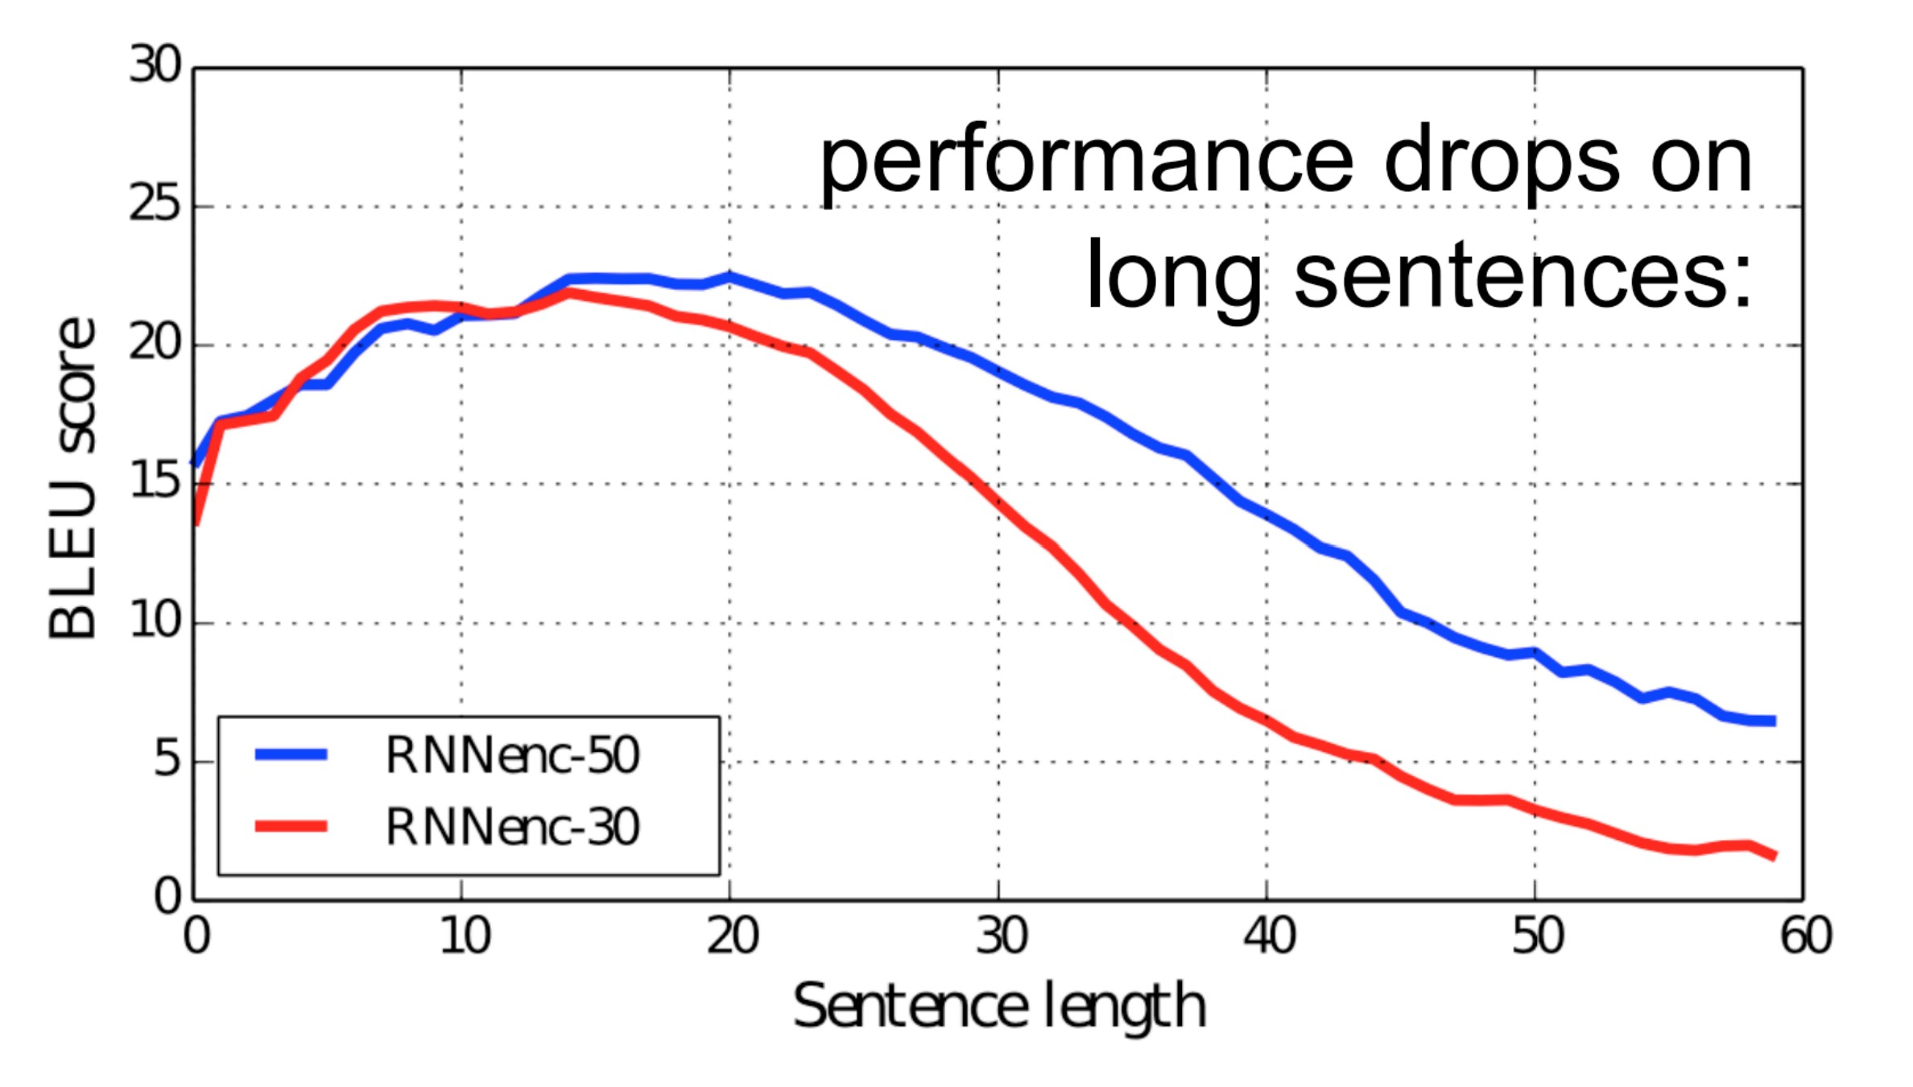
Weakness RNN

Slide 33
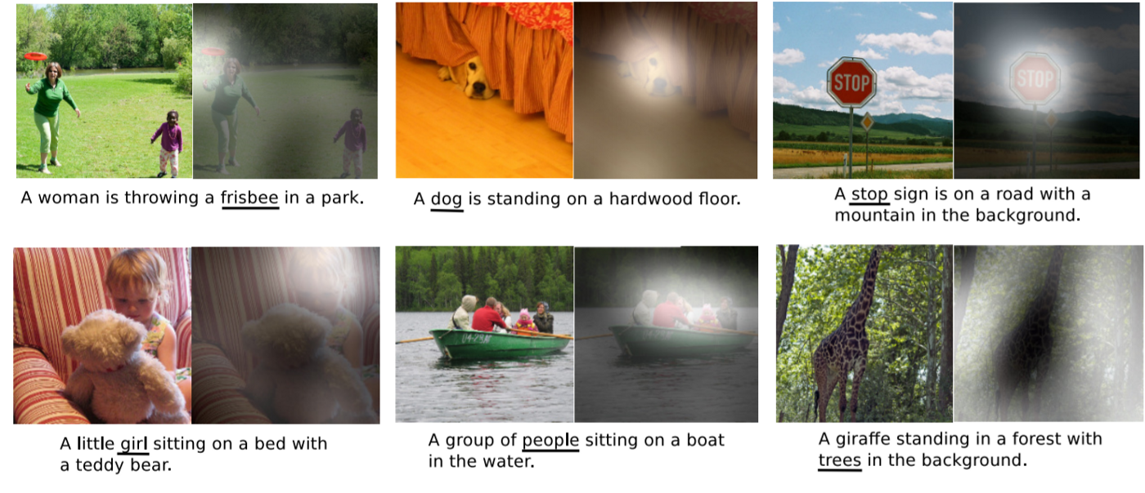
Attention Mechanism
In psychology, attention is the cognitive process of selectively concentrating on one or a few things while ignoring others

Slide 34
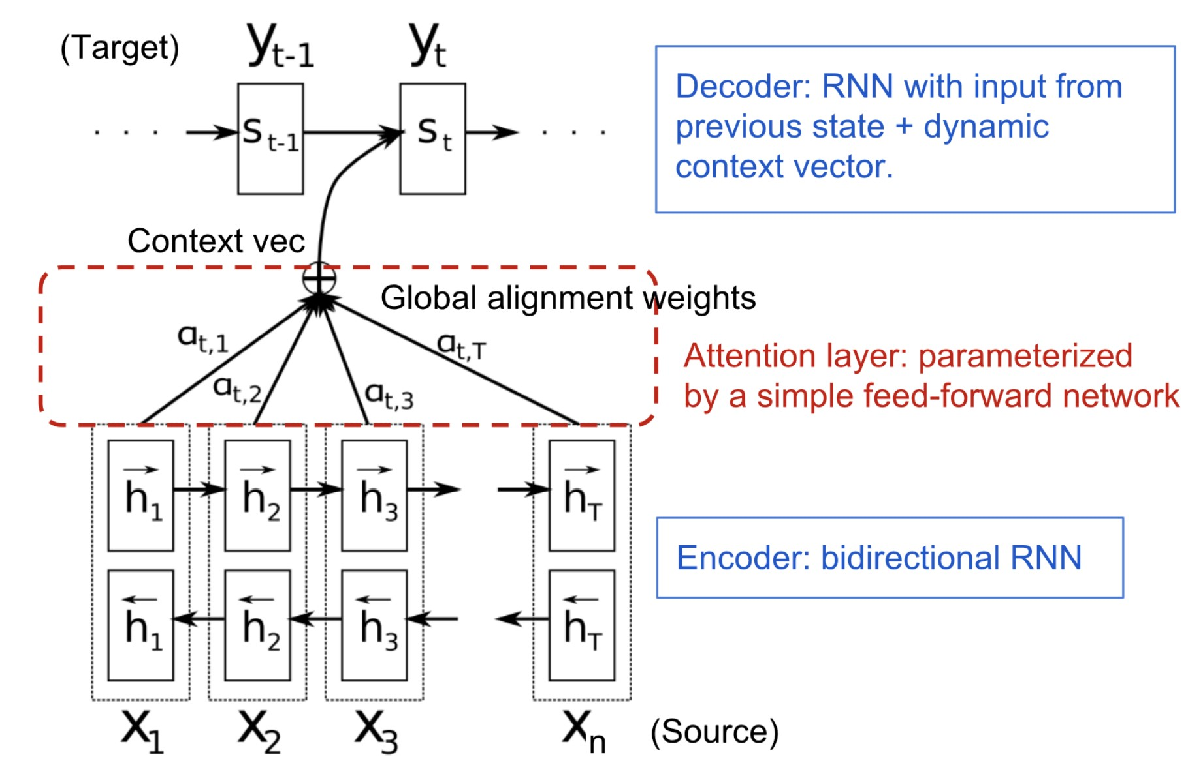
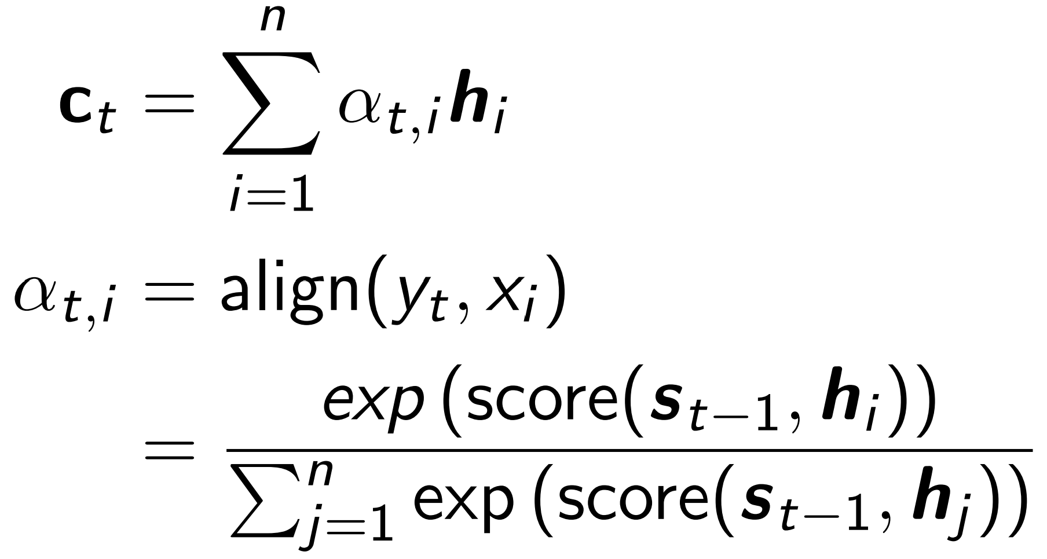
Attention + RNN
Instead of building a single context vector out of the encoder’s last hidden state, the goal of attention is to create shortcuts between the context vector and the entire source input (Bahdanau, Cho, and Bengio 2015).

Slide 35
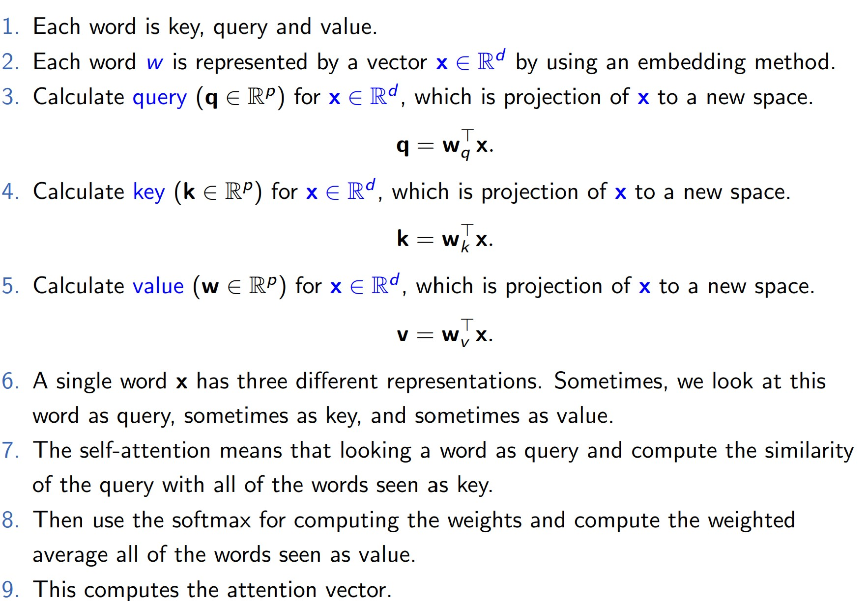
Self Attention

Slide 36
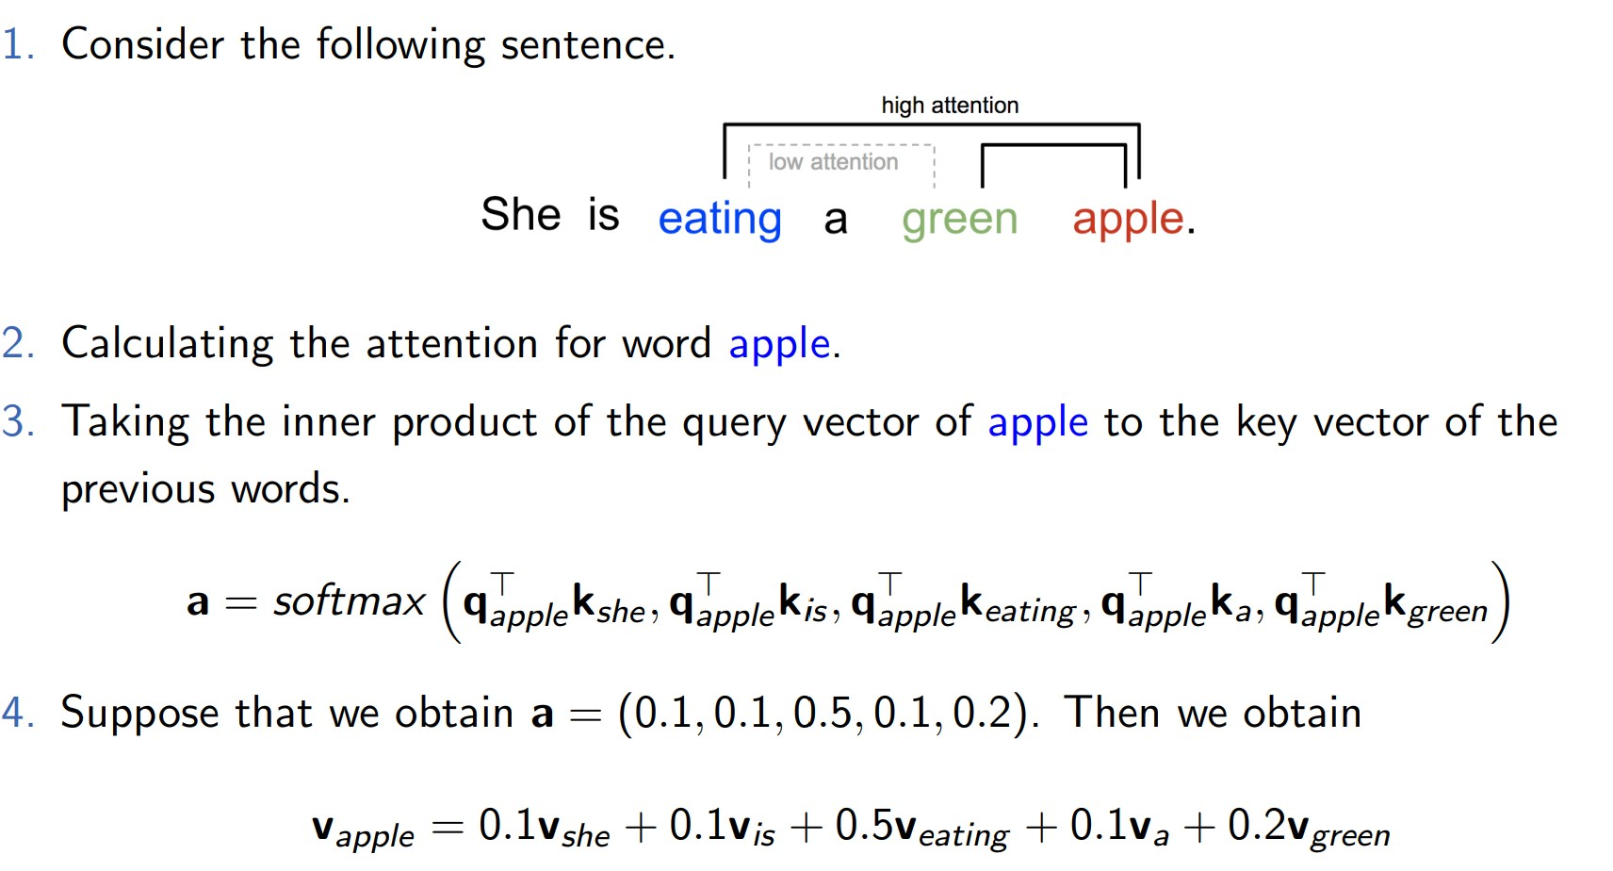
Self Attention

Slide 37
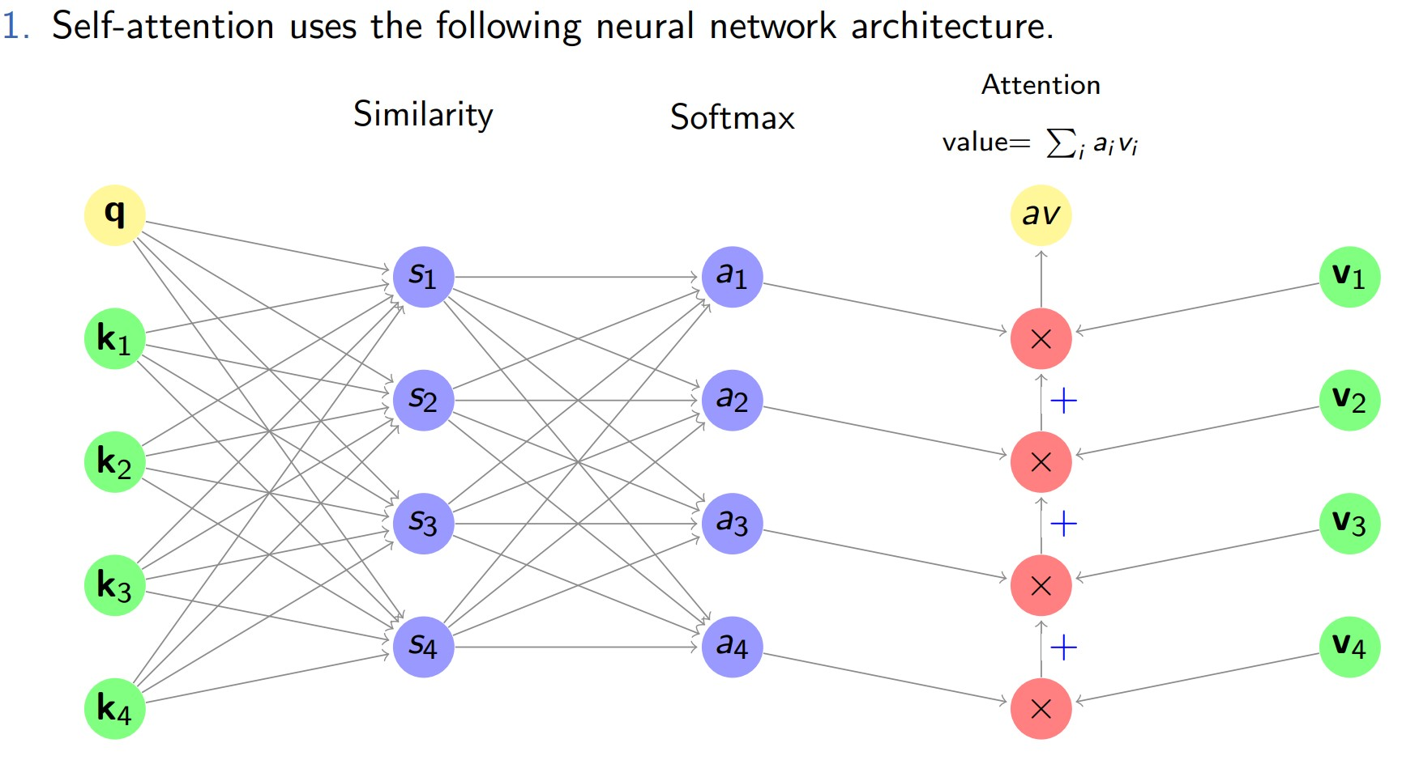
Attention is all you need (Vaswani et al., 2017)

Slide 38
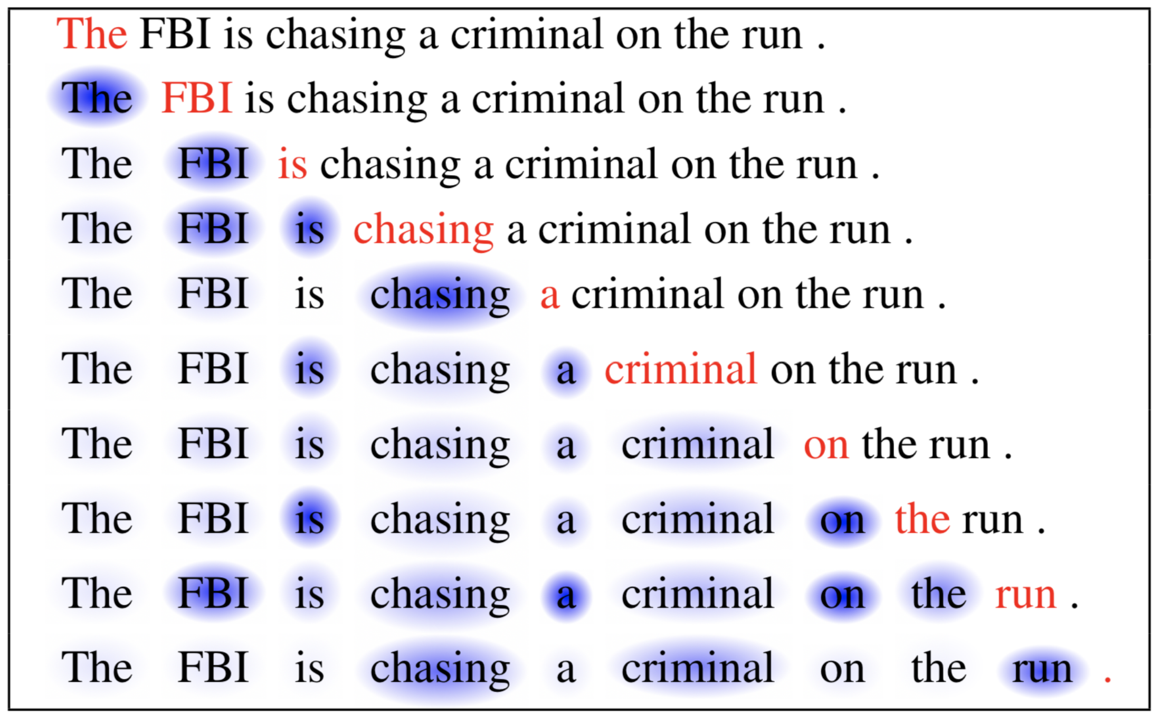
Attention Example

Slide 39
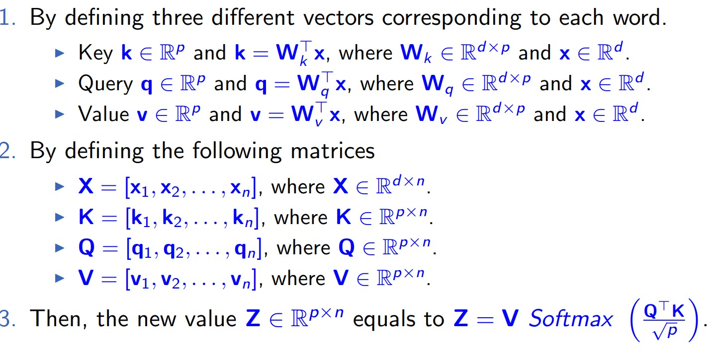
Multi-head Attention
Notes:
Multi-head

Slide 40
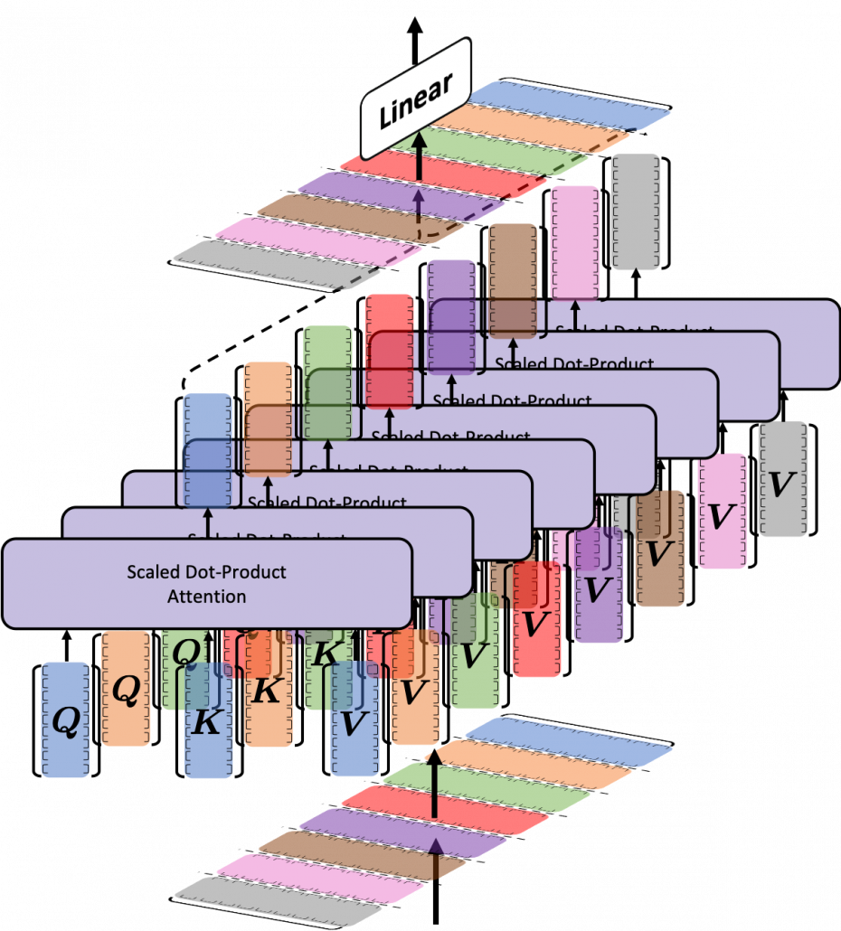
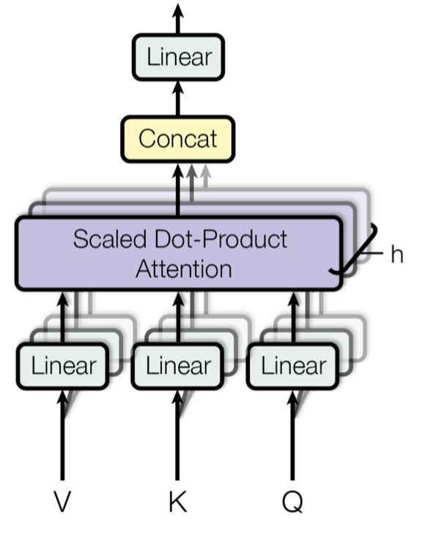
Multi-head Attention
Notes:
Multi-head

Slide 41

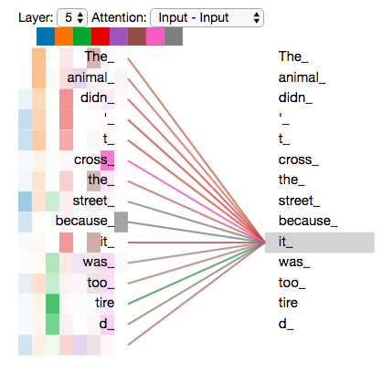
Single Attention V.S Multi-head Attention
Notes:
Multi-head

Slide 42

Transformer Block
Notes:
We don’t need decoder block

Slide 43
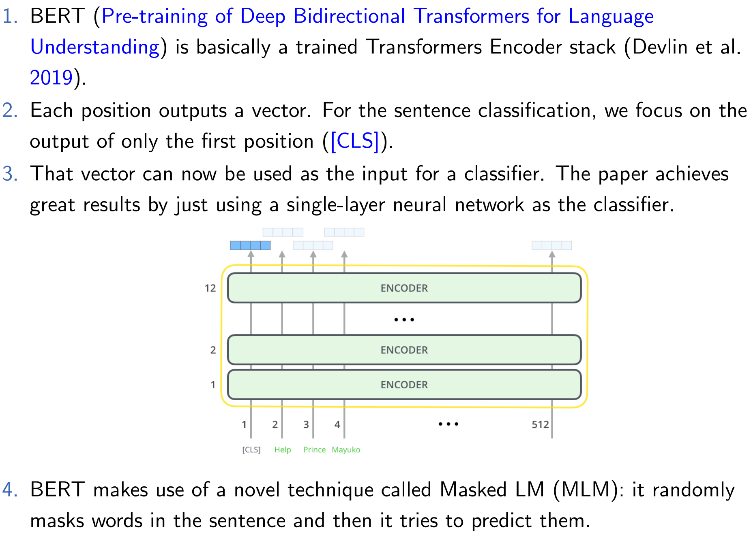
BERT for Language Model

Slide 44
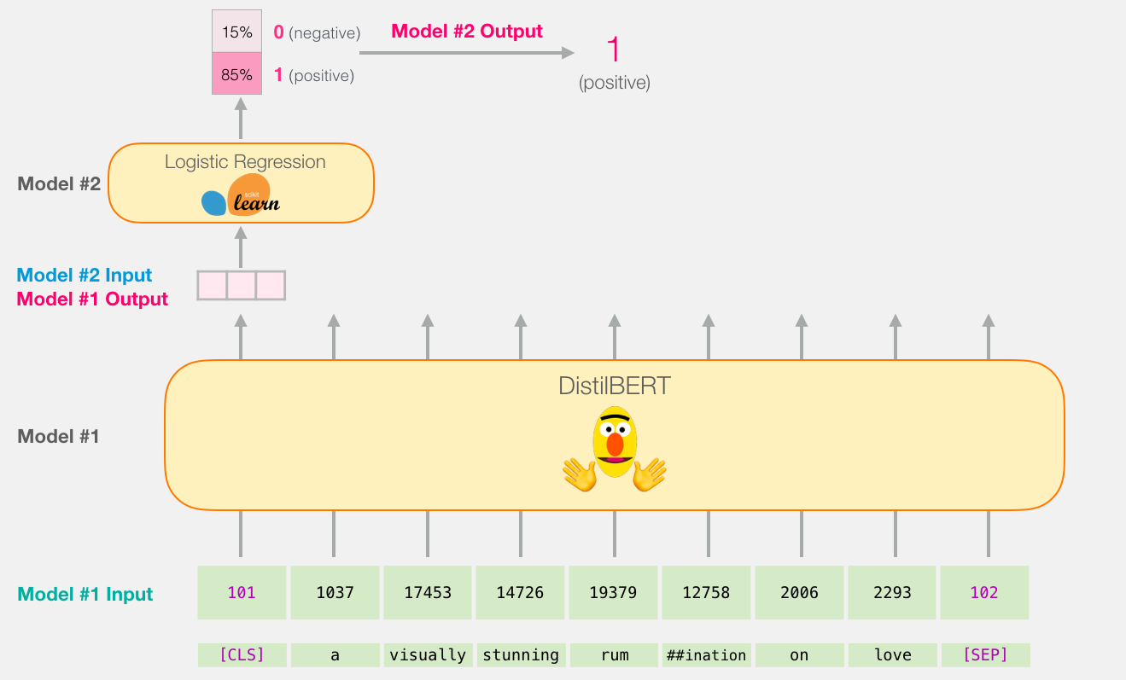
Classification with BERT Model

Slide 45
References
Alain, Guillaume and Yoshua Bengio (2014). “What Regularized Auto-Encoders Learn from the Data-Generating Distribution”. In: Journal of Machine Learning Research 15.110, pp. 3743–3773. url: http://jmlr.org/papers/v15/alain14a.html.
Vaswani, Ashish et al. (2017). “Attention is All you Need”. In: Advances in Neural Information Processing Systems, pp. 5998–6008.
Devlin, Jacob et al. (2019). “BERT: Pre-training of Deep Bidirectional Transformers for Language Understanding”. In: Proc. of Conf. of the North American Chapter of the Association for Computational Linguistics: Human Language Technologies, pp. 4171–4186.

